Slide 1
Website Layout

Slide 2
Basic page layout (Kids & Us)
Why African languages
About us: Our mission and method incl languages offered
Benefits of learning languages​
FAQs
When are lessons
What languages do you offer
Courses
Our methods and immersion approach​ plus proficiency
Toddlers
Preschoolers
Primary schoolers
Teens
Adults
Enrol
Universe
Online Lessons
At home enhancement​
Play dates in the target language​
Storytelling
Theme outings
Language exchanges
(Library)
(Transport to and from Rera)
Sign-up​
Before you enrol​
Free trial class
Class sign up​
Language exchange sign up
(policies)
(School partnerships)
Links​
Language blogs e.g. bilingual monkeys
(Other Rera companies)
(Translation services)
Get in Touch​
Contact us (form and address)​
Register for a free class​
Refer a school​
Refer a friend​
Newsletter sign-up​
CSI: Giving Back
(Language Learning Tools / Shop)

Slide 3

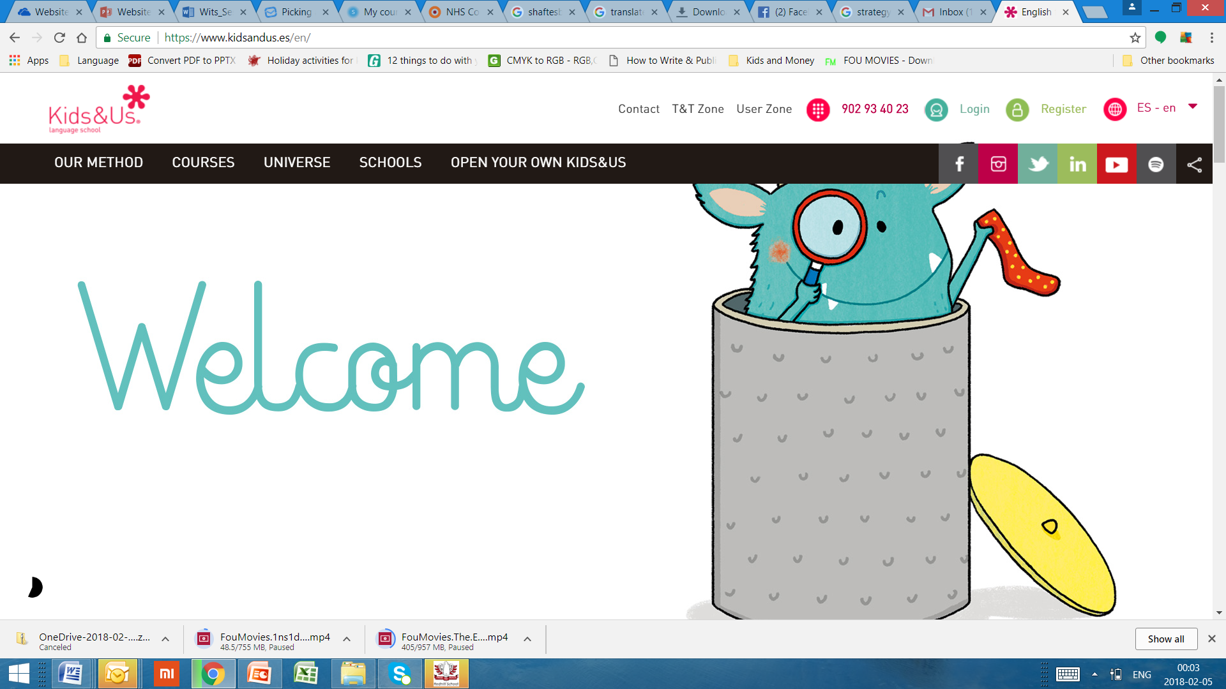

logo
Enrol/Sign Up
Log In
Connect with Us
Why African languages
Courses
Universe
School Partnership
Links
CSI
Boost your linguistic universe with African languages
Key Facts about Rera
Immersion approach with minimal English used
Fun activities for all ages
In person and online courses for children and adults
In person and online Sesotho lessons started for children and adults
isiZulu and chiShona to begin in June and more to come over time
Integrated communication skills together with music, arts and craft
Regular feedback on progress
Language Learning as an Extracurricular
Learning a heritage or second language helps with social skills , self-esteem, and creating connectedness with others
Wider cultural understanding through immersion in an language and designed cultural activities
Greater opportunity for communication in the communities we live in or visit
Multilingualisam is a norm in South Africa as in most other countries
Complete Our Survey and Get a Trial Lesson
Help us understand your needs better and receive a trial lesson in isiZulu, chiShona or Sesotho for yourself or your child
10 minute long questionnaire
Opportunity to pre-register for upcoming courses
Free Trial Class
Click here for survey
Read More (leads to mission and programmes)
Read More (leads to courses for children)
Click here for survey
Click here for trial
Copyright © 2018
Rera Language School
Aboute
Privacy statement
PAIA
Terms of use

Slide 4
logo
ENG|ISIZULU|SESOTHO|CHISHONA (use selected course impage)
Enrol/Sign Up
Log In
Connect with Us
Why African languages
Courses
Universe
School Partnership
Links
CSI
About us:
Our mission
Our method
Languages offered:
Sesotho
isiZulu
chiShona
More to follow
Benefits of learning language
FAQs

Slide 5
Good website layouts
Best
https://www.kidsandus.es/en/
http://zoomlanguage.com/
https://languageprojectkids.com/
http://www.chinesewithmeggie.com/
http://www.bambinilingo.co.uk/
https://spongeschool.com/
Good
http://www.languagestars.com/
http://www.childrencenterlanguage.com/
http://www.languageleague.com/
http://www.ladante.co.za/
http://kaixinchinese.com.au/
http://www.learningadventures.com.au/
http://www.langokids.com/

Slide 6
